Slide 1
Learn to Use Self-Hypnosis
to Reduce Stress, Lose Weight, Stop Smoking & Be Healthier
The Truth About Hypnosis

Slide 2
Glen Bledsoe
Consulting Hypnotist
Notes:
Good morning! My name is Glen Bledsoe and I am, among other things, a consulting hypnotist or hypnotherapist as we were called in the past. We are all of us here Renaissance people with many interests and talents, aren't we? In 1991 I graduated from WU with an MAT, and I’ve taught K-8 for the last 25 years with short forays into higher education. I’m in my penultimate year of teaching middle school art and technology.

Slide 3
Notes:
I work at Oak Springs Wellness Centre in Salem, where I get to work with a massage therapist, a yoga instructor, and many talented counselors.

Slide 4
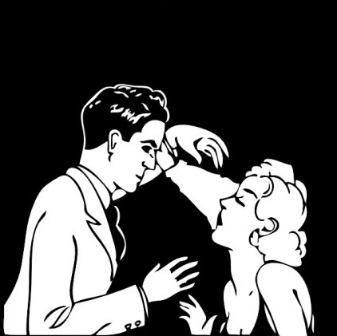
Teacher => Hypnotist?
Notes:
How one goes from being a teacher to a hypnotist is a story for another day because I’m here to tell you what hypnosis can do for you.

Slide 5
?
Notes:
Teachers, administrators, health professionals, ?, Salem, work hard every day, feel stress, time, speeches, testing, lose weight or, manage pain or, stop a habit like smoking or, create a new habit like developing a fitness lifestyle, just curious?

Slide 6
What is hypnosis?
Notes:
Before…

Slide 7
What hypnosis is NOT!

Slide 8
Notes:
Hypnosis is not mind control. Hypnosis can’t make you do anything that you don't want to do. If this were so hypnotists would be the wealthiest and most powerful people on the plant. They aren’t.

Slide 9
SECRET!
Notes:
No one can force you to tell secrets while in hypnosis. If this were true I’d have a gig with the FBI.

Slide 10
Notes:
Hypnosis won’t make you lose control.

Slide 11
Notes:
Hypnosis cannot regress you to a past life. Past lives are a religious belief and as such you would no more see your hypnotist to find out about a past life than you would your dentist.

Slide 12
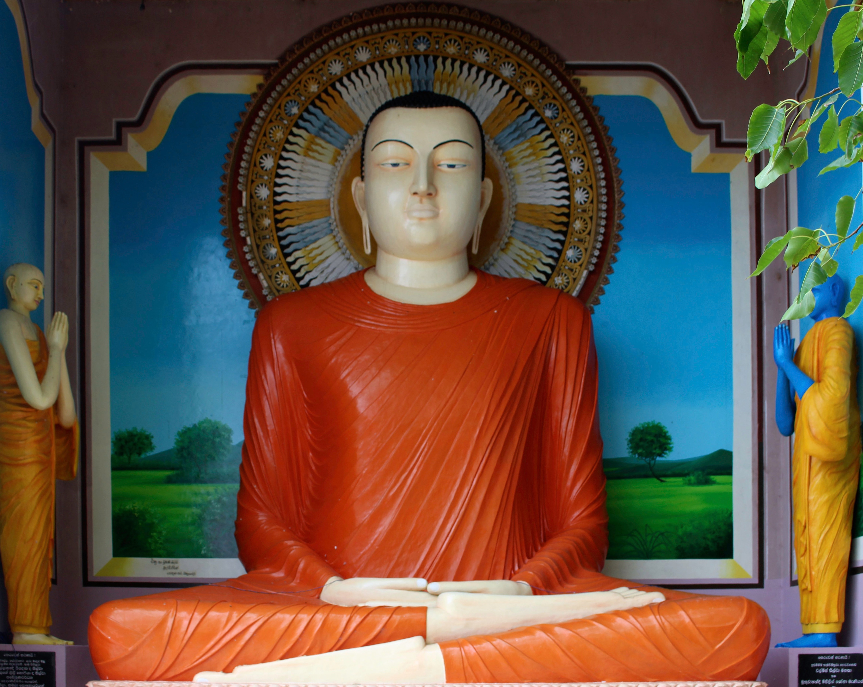
Notes:
If you believe that you may have had a past life, and you want intelligent discussion on the topic talk to a Buddhist priest.

Slide 13
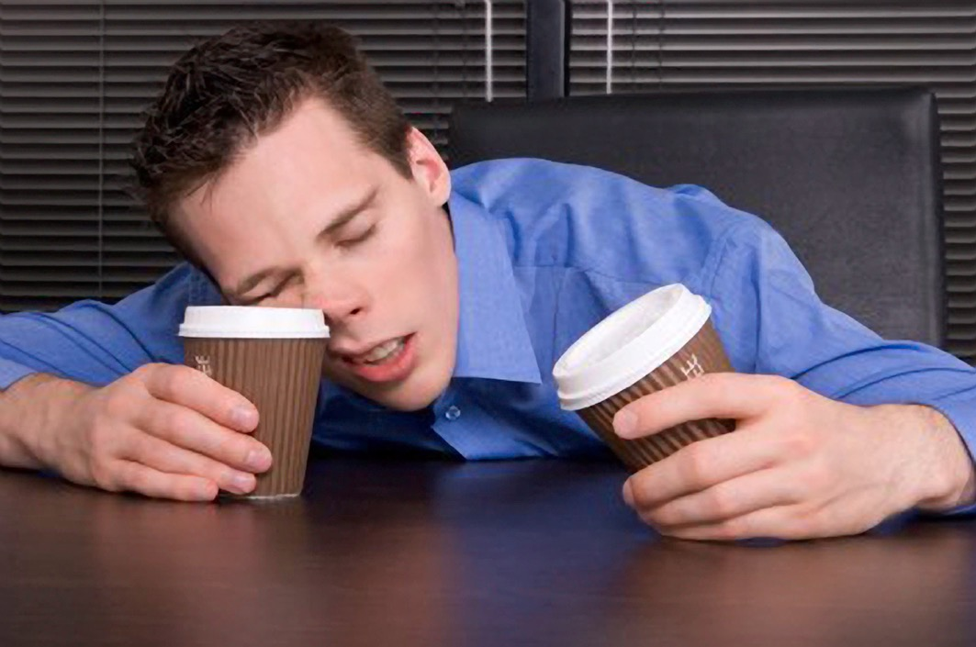
hypnosis ≠ sleep
Notes:
Hypnosis is not sleep. Focused day dream. Cultural invitation sleep = enter into trance state.

Slide 14
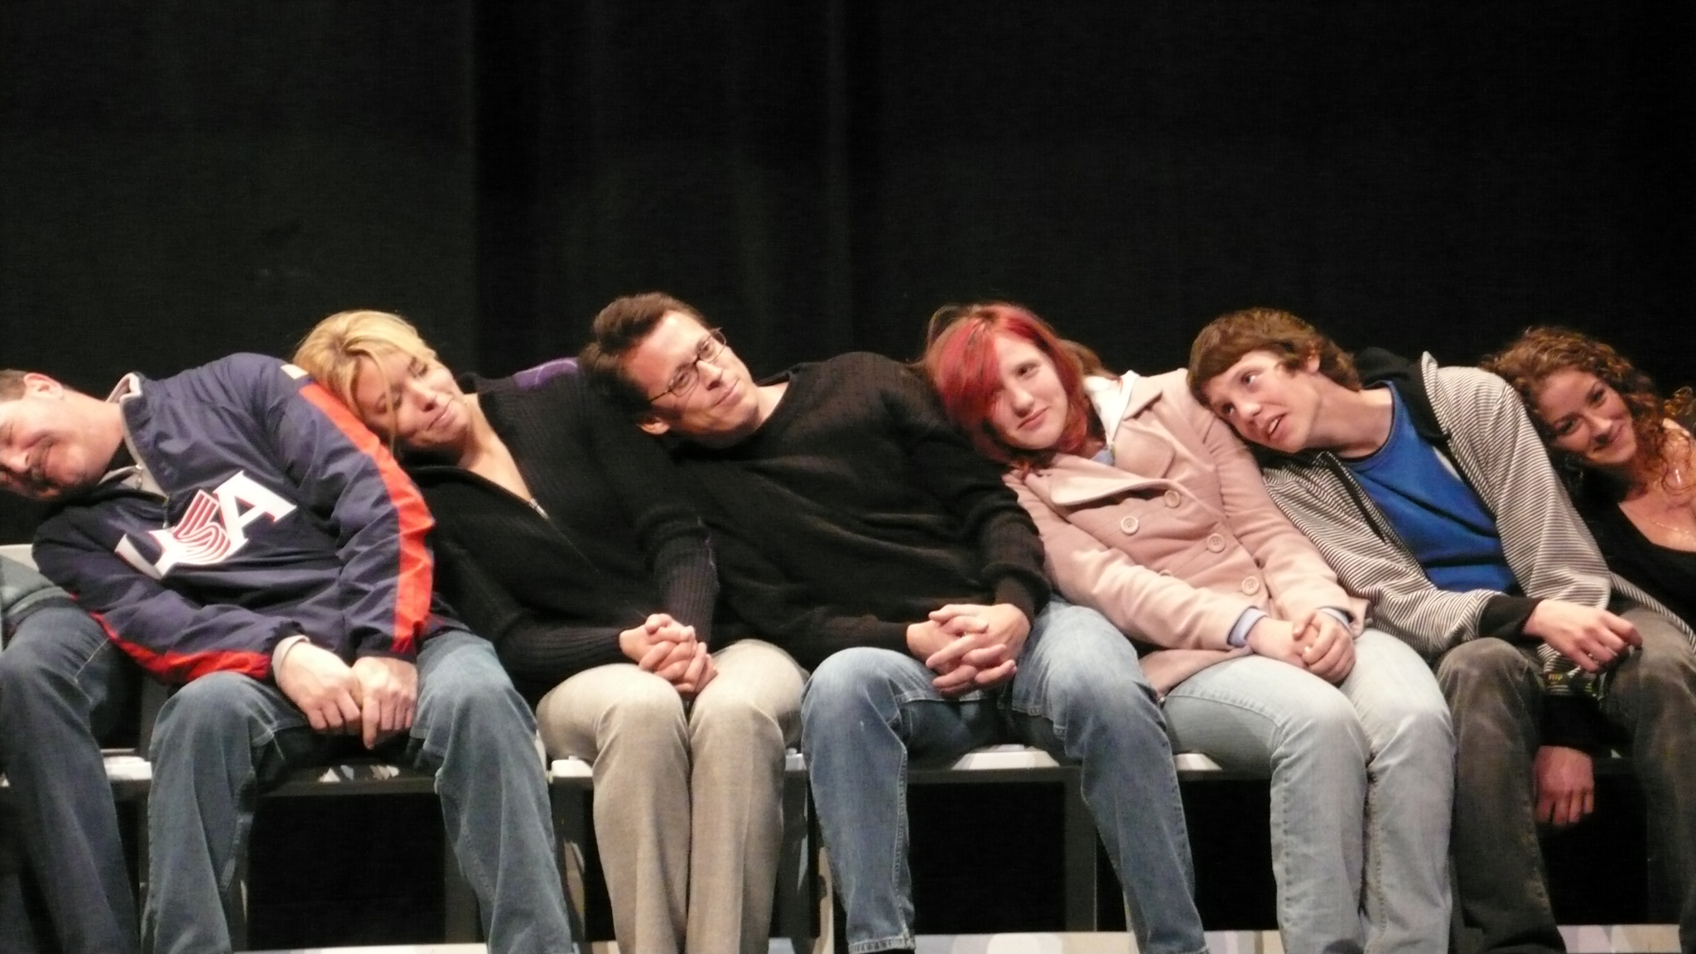
What about stage hypnotists?
Notes:
So if a hypnotist can’t make anyone do anything in hypnosis they don't want to do why do people act like idiots during hypnosis comedy show? Short answer: because some people enjoy acting like idiots whether they are hypnotized or not. Consider:
•Stage hypnotists ask for volunteers who know only too well what is expected of them.
•Even so some people on stage won't experience hypnosis and are cheerfully asked to return to the audience. “You’ll enjoy the show out there better than up here,” is what they’re usually told.
•The people who do volunteer to go on stage are often extreme extroverts and enjoy the attention and opportunity to perform for large crowds. Some of these people return year after year to stage hypnosis shows because they like the experience so much. Give these people a couple of beers and they'd likely do the same thing.

Slide 15
What about stage hypnotists?
Notes:
•Looking at the faces of the people in the photo I'd be surprised if any of them are hypnotized by the look on their faces. Most of their eyes aren’t even closed. Not that you have to close your eyes to be hypnotized.

Slide 16
Notes:
This may be fun for some people, but unfortunately stage hypnotists create a misunderstanding and fear of hypnosis in the mind of the public, which is a real impediment to the use of hypnosis for beneficial purposes. After reading the above would you go to a hypnotist to lose weight? You might well be afraid you’d be humiliated.

Slide 17
consciousness
Notes:
I think of our minds as cell phones. We have many apps that manage our body and our interpretation and sense of reality. One of those apps is consciousness. It seems bigger and more important to us because it gives us a sense of self-awareness. It solves problems and acts as a critical filter. It doesn’t do more than about 7 things very well at once. Other apps might be to digest your food, heal your wounds, control your heart rate, store your learning, store your memories, stories your morals and values, and hundred of other apps all operating at the same time.

Slide 18
Notes:
If you leave this talk with nothing else, leave understanding that hypnosis is not mind control.

Slide 19
Hypnosis in Education
Notes:
Florida principal George Kenney meant to help students using hypnosis. Three students died after experiencing an induction. (One in a car accident and two suicide.) They also probably ate cafeteria food and had dental exams during the previous six months. It’s unfortunate but a few of our students attempt to harm themselves with no link to having experienced hypnosis. Mr. Kenney got into trouble not for the students harming themselves, but for practicing hypnosis without a license. He was an over-enthusiastic amateur. He did no harm and likely did a great deal of good. It’s unfortunate that the media has sensationalized this and damaged a potentially useful tool for educators. The truth is we are all being subject to hypnosis whenever we read a book, watch a movie, and we are especially susceptible to trance when we sit in front of the TV and advertisers know only too well.
Which doesn’t mean that hypnosis has no use in education. More about that later…

Slide 20
What is hypnosis?
Notes:
Nobody really knows. Theories have been proposed for several hundred years. It doesn’t matter how hypnosis works so long as we know how to use it. I don’t know how my cell phone works, but I know how to use it.

Slide 21
Hypnosis is the seeding of suggestions into the subconscious mind…
Notes:
This is my working definition.

Slide 22
to change our perception of reality…

Slide 23
best put to the use of improving our lives and getting us more of the things we want and need.
Notes:
Notice there is no mention of the word “trance.” That’s because trance isn't needed to produce the results of hypnosis. It makes hypnosis easier, but isn't strictly necessary.

Slide 24
Hypnosis is
Complementary medicine
rather than
alternative medicine
Notes:
alternative medicine implies practices that have no scientific verification. There is a great deal of scientific evidence on the validity of hypnosis.

Slide 25
Rx
SIDE EFFECTS: Dizziness or headache may occur. If any of these effects persist or worsen, tell your doctor or pharmacist promptly.
Remember that your doctor has prescribed this medication because he or she has judged that the benefit to you is greater than the risk of side effects. Many people using this medication do not have serious side effects.
Indapamide may cause too much body water and salts to be lost (dehydration). Prolonged diarrhea, vomiting, or excessive sweating can increase this risk. To prevent dehydration, drink plenty of fluids unless otherwise directed by your doctor. Tell your doctor promptly if you have any symptoms of dehydration, including: fast/irregular heartbeat, unusual dry mouth/thirst, muscle cramps/pain, unusual decreased urination, weakness.
This medication may infrequently make your blood sugar level rise, which can cause or worsen diabetes. Tell your doctor immediately if you develop symptoms of high blood sugar, such as unusual increased thirst and urination. If you already have diabetes, be sure to check your blood sugars regularly. Your doctor may need to adjust your diabetes medication, exercise program, or diet.
Get medical help right away if you have any very serious side effects, including: decrease in vision, eye pain.
A very serious allergic reaction to this drug is rare. However, seek immediate medical attention if you notice symptoms of a serious allergic reaction, including: rash, itching/swelling (especially of the face/tongue/throat), severe dizziness, trouble breathing.
This is not a complete list of possible side effects. If you notice other effects not listed above, contact your doctor or pharmacist.
Notes:
Here is a list of side effects for a pharmacological health treatments.

Slide 26
Hypnosis
•Non-habit forming
•No on-going costs
•No side effects
•Proven medically effective for a number of medical conditions (as effective or more effective than pharmaceuticals)
Notes:
Why isn’t hypnosis used more often? Hypnosis takes time which most doctors don’t have. Hypnotists listen to their clients closely. A common complaint I hear is that “my doctor doesn’t listen to me.” The Big Pharma lobby has got a lot more muscle than the hypnosis lobby.

Slide 27
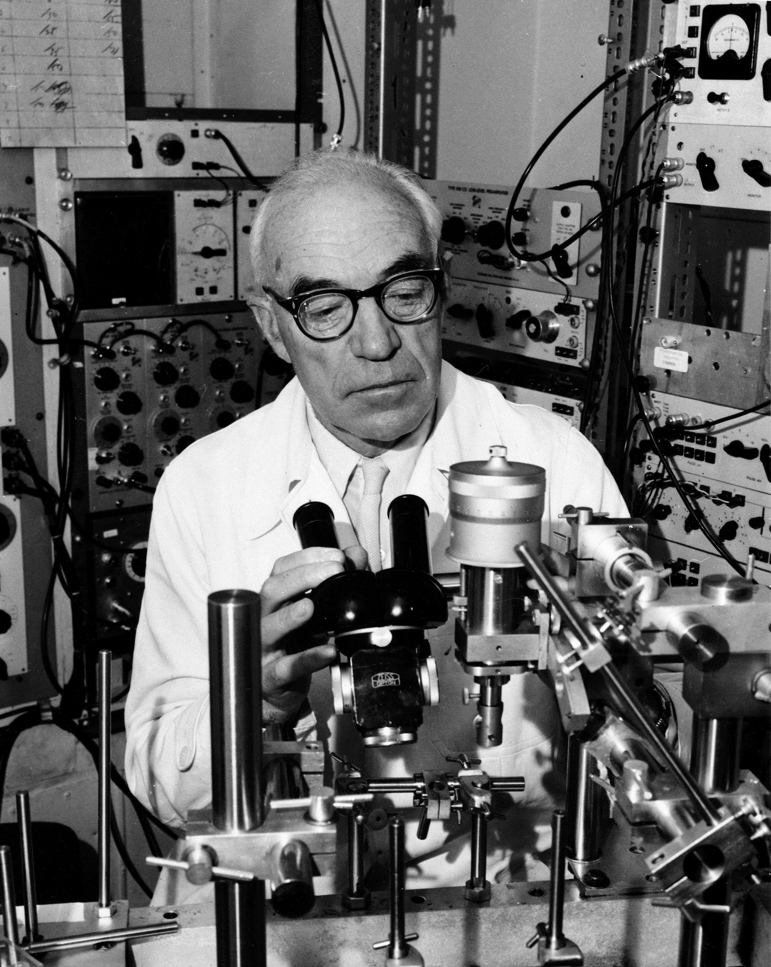
Sir John Eccles
Notes:
Sir John Eccles, neuro-physiologist, winner of the Nobel prize for Physiology or Medicine 1963, made the following statement, which is really key to the whole thing.

Slide 28
"I want you to know that there are no colors in the real world,

Slide 29
there are no fragrances in the real world,

Slide 30
that there’s no beauty and there’s no ugliness…

Slide 31
Out there beyond the limits of our perceptual apparatus

Slide 32
is the erratically ambiguous and ceaselessly flowing quantum soup…

Slide 33
And we’re almost like magicians in that in the very act of perception, we take that quantum soup and

Slide 34
we convert it into the experience of material reality in our ordinary everyday waking state of consciousness.”
Notes:
Which means our minds decide how we interpret the universe around us. And because our minds are our user interface we can alter our experience of the world by altering our minds in simple and healthy ways using suggestions planted in the subconscious mind. This we call hypnosis.

Slide 35
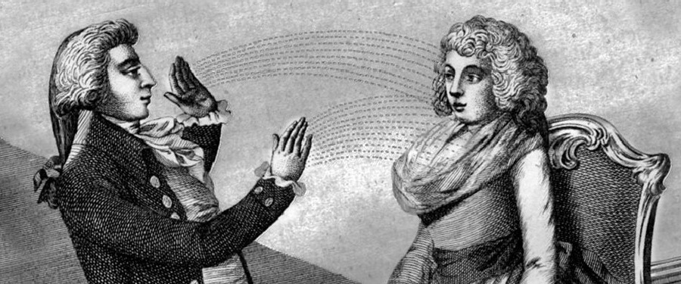
Uses of hypnosis

Slide 36
Stress reduction
relax relax relax relax & relax even more…
Notes:
The word hypnosis is synonymous with relaxation, although a person can experience hypnosis under noisy and stressful situations. Hypnosis can be used in emergency rooms.

Slide 37
Smoking Cessation
Quit Now!
Notes:
It seems like everyone knows someone who stopped smoking using hypnosis. Claims of success, however, (100% in one session) are somewhat exaggerated. About 30% are able to stop after one session. Medical research show that about 70% of smokers stop smoking using hypnosis in 4 to 5 sessions. Better than nicotine patches. It takes a highly motivated person to stop smoking. Remember the hypnotist can't make you do anything. But I have had many clients walk into my office smokers and leave the office non-smokers even those who aren’t sure they “believe in hypnosis.” It’s like flipping a switch.

Slide 38
Pain Control
"...hypnosis offers one of the most promising new clinical approaches to pain control.
Although it has been a form of treatment for more than a century, only recently has it been recognized as an empirically supported approach to pain control." Clinical Hypnosis for Pain Control (David R. Patterson Ph.D.)
Notes:
It’s well worth mentioning, although it’s perhaps a little beyond the scope of this presentation, that in my opinion the most potent use of hypnosis is in pain control. Research and confirmation of the efficacy of hypnosis in managing pain builds and builds and builds.
For me, while I enjoy helping people quit smoking, lose weight and reduce their stress, I feel like I've done some real good when I can help people deal with acute and especially chronic pain.

Slide 39
Fitness
&
Weight Loss
Be healthy in
ALL
ways
Notes:
Hypnosis in combination with a change in physical activity and eating habits can be effective in losing much, much more.

Slide 40
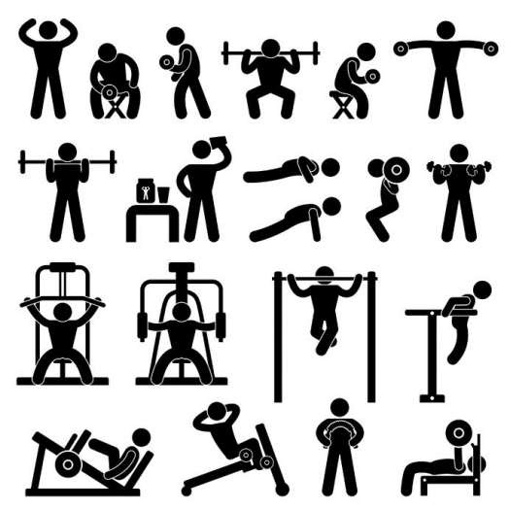
The process is the goal.
Notes:
Hypnosis can help you create a healthier life style.

Slide 41
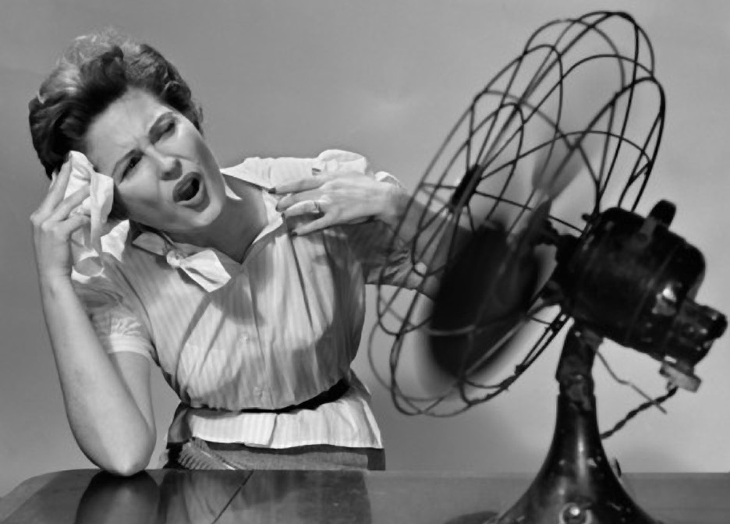
Notes:
Menopause/hot flashes. Hypnosis has been found to help to cut hot flashes by about 80% (combining frequency and severity). 75% fewer flashes.

Slide 42
Even more uses…
regression, sports performance, forensic investigation, test anxiety/hypermnesia, phobias, etc.
Notes:
There are many other purposes to which hypnosis might be applied: time regression (forensic hypnosis), sports performance, test anxiety, hypnosis for travelers, and so on. There are uses we probably haven’t even thought of.

Slide 43
5 minute BREAK
Notes:
Take five minutes to stretch and to walk around and say hello to your neighbor if you haven’t already done so. When we come back I’ll first take questions, second explain to you how to do self-hypnosis, and finally we can all enjoy the remainder of the time in a relaxing group induction.

Slide 44
?
Notes:
Questions

Slide 45
Self-Hypnosis

Slide 46
You will always have better results working with a good hypnotist than working with only self-hypnosis. This is because a hypnotist can custom design suggestions based on your answers to questions you give during an interview. A good hypnotist will watch your breathing, watch your physical reactions to suggestions and present suggestions only when you are ready for them. I usually try to give suggestions when my client is exhaling, but it’s a intuitive process on my part and there are no hard rules I follow.

Slide 47
But self-hypnosis is better than no hypnosis, and self-hypnosis can support suggestions given by your hypnotherapist.

Slide 48
Breathing
•To prepare for a self-hypnosis session it’s best to calm the mind with breathing. Make yourself comfortable in every way. I suggest you do your self-hypnosis as you go to sleep each night.
•The pattern is to slowly inhale for the count of 3, hold for the count of 3, then exhale for the count of 3. You’ll repeat this sequence 3 times. Over time extend the count from 3 to 5, and with more practice to 8.

Slide 49
The easiest way to do self-hypnosis is to make an audio recording. Most cellphones, iPads and similar devices have ways to make audio recordings. When you play back the recording set it to loop if you can and after a couple of hours you will automatically wake up, turn off the recording then immediately go back to sleep for the rest of the night.

Slide 50
Safety
Always be careful not to get the cord to your headphone or earphones wrapped around your neck.
Never listen to your recording while driving a car or operating heavy equipment.

Slide 51
First you need to determine a goal.

Slide 52
Next you’ll want to make a script. This script will contain the suggestions for you to reach your goal.

Slide 53
Let’s say your goal is to create a healthier life style. You’ll want to start with a few consequences of your not reaching your goal. Then you’ll want to give a long and thorough list of the benefits of reaching your goal. These should require you to visualize the effect of the suggestions. They follow a pattern which begins with “I picture myself…” Your suggestions might go something like this:

Slide 54
[negative]
I picture myself growing soft and I am unhappy with my sloth.
I picture myself eating the wrong kind of food and feeling sick.
I picture myself sitting on the couch and envying the level of fitness of the people on TV.

Slide 55
[positive]
I picture myself choosing the right kind of foods to eat and I feel more energetic.
I picture myself walking on a treadmill engaging in an activity that triggers endorphins in my brain.
I picture myself buying clothes that flatter my new and always improving physique.

Slide 56
[more positives]
I picture myself walking by a box of donuts with no desire to even think of eating one and hearing applause in my head.
I picture myself reflecting on my new healthy lifestyle and feeling a deep sense of satisfaction and self-control.
I picture myself getting better in every way and I feel like I can rock the world.

Slide 57
Make your list of positives as long as you want matching what you picture in your mind with a consequential reward of some kind. Think of all the senses you have, all the emotions you can tap into. Pride, satisfaction, self-control, success, and so on.

Slide 58
Usually you’ll want to speak softly, but a few suggestions such as feeling pride for your accomplishments can be delivered with the emotional sense you wish to invoke.

Slide 59
Space out the suggestions. You can leave as much as 30 seconds between sentences. You can even break up the sentences into phrases with a few seconds space in separation.

Slide 60
Initially listen to your recording every night, and as you begin to notice the positive results you can begin to reduce the frequency a little week by week. Once the mental habits are in place you will no longer need the recording unless you feel yourself slipping.

Slide 61
http://tinyurl.com/z5rplpk

Slide 62
Demonstration

Slide 63
In the future if I can be of assistance to you in any way, please let me know.
Notes:
Contact information is on the handouts.

Slide 64
-15%
Notes:
For those who live in the greater Salem area and are interested in my services I’m offering a 15% discount. Just mention the OEBB Wellness Conference when you schedule your appointment.

Slide 65
The Educational Hypnosis Handbook
coming this summer…
A Practical Guide to the Use of Persuasive Language Patterns in the Classroom
Notes:
While it’s outside the purpose of this event, I am working on a book for teachers to use [non-trance] conversational hypnosis for classroom management and especially for resistant learners.

Slide 66
Thank you!
Notes:
I thank you for your time and attention.

