Slide 1
LAUGHACEUTICALS: Laughter and Play as Wellness

Slide 2
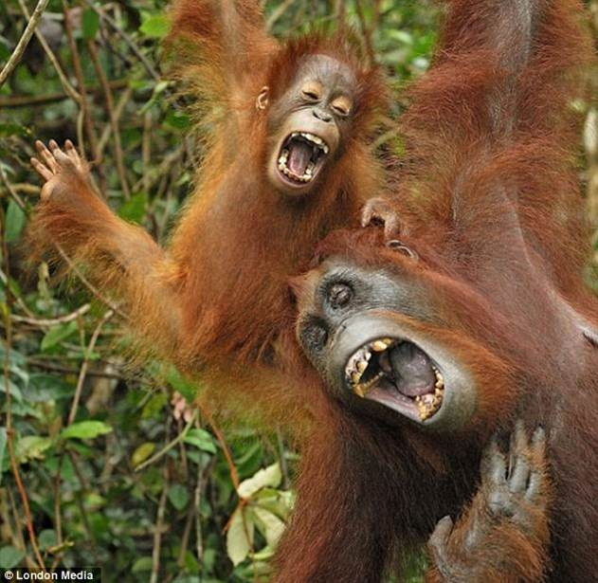
Stephanie Cordell
Tricia Castañeda-Gonzales
etpnorthwest.org

Slide 3
Definition of Play
Defining play is difficult because it’s a moving target. [It’s] a process, not a thing. In between you find surprise, pleasure, understanding - as skill and empathy - and strength of mind, body, and spirit.
~Scott G. Eberle, Ph.D., Vice President; Play Studies at The Strong;
Editor; American Journal of Play
Playing is the voluntary attempt to overcome unnecessary obstacles.
~Bernard Suits, Philosopher, Author; The Grasshopper:Games, Life, and Utopia

Slide 4
OBJECTIVES
Participants will gain an understanding of research demonstrating the positive health benefits of play and laughter.
Participants will apply concepts of play, laughter, and connection as tools to cultivate well-being.
Participants will leave with practical tools to manage stress and anxiety, to create a healthy work environment, and to foster social cohesion.

Slide 5
Benefits of Play & Laughter
Improve respiration & breathing
Increase pain tolerance Reduce stress, anxiety & tension Decrease depression, loneliness & anger Improve mental functioning

Slide 6
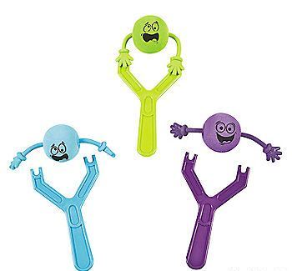
What is play?
etpnorthwest.org

Slide 7
Qualities of Play
Apparently Purposeless Voluntary Inherent Attraction Freedom from Time Diminished Consciousness of Self Improvisational Potential Continuation Desire
~ Stuart Brown, M.D., Author; Play: How it Shapes the Brain, Opens the Imagination and Invigorates the Soul

Slide 8
Me Too!
etpnorthwest.org

Slide 9
Some of the psychological benefits of laughter include increased self-esteem, increased creativity and improved coping abilities. ~Dr. Lee Berk, Loma Linda University Medical Center

Slide 10
Individuals who play frequently are more likely to have a really good sense of trust. They have a greater facility when it comes to self regulation and conflict resolution. Groups that play frequently also tend to be healthier.
~Jill Vialet, CEO and Founder of Playworks

Slide 11
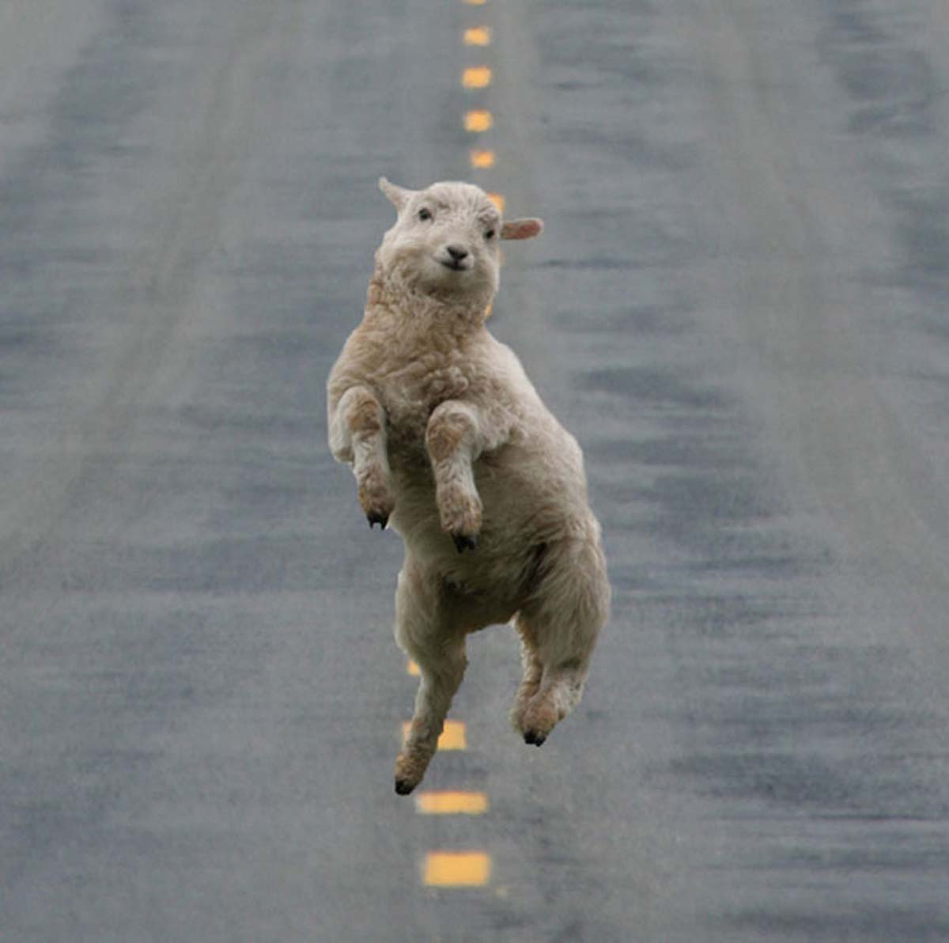
Stop Walk Jump Clap
etpnorthwest.org

Slide 12
Definition of Stress The body’s response (mental or physical) to change. Types of Stress Eustress & Distress

Slide 13
People who tend to have a humorous outlook on life also report experiencing less stress. Laughter reduces stress.
~Dr. Lee Berk, Loma Linda University Medical Center

Slide 14
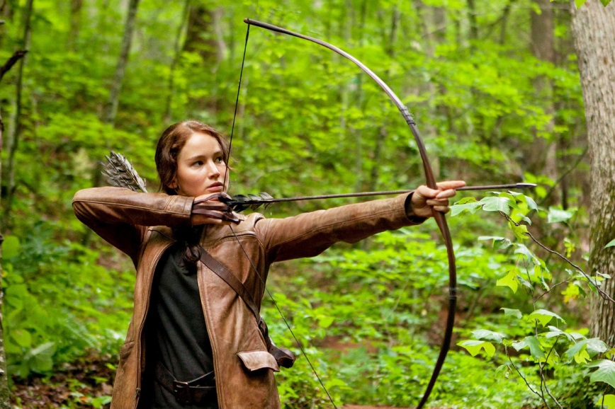
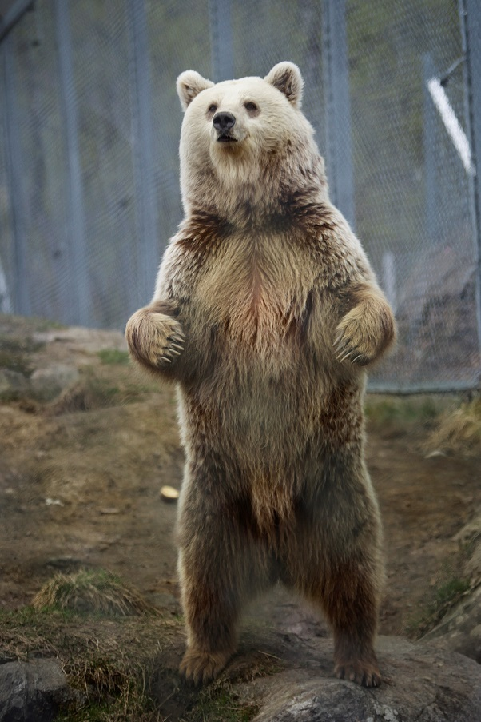
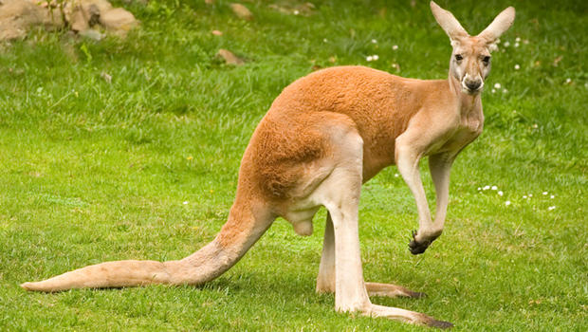
Three Pictures
etpnorthwest.org

Slide 15
Shield and Toxin
etpnorthwest.org

Slide 16
Play matters
because it compels us to choose,
to put a stake in the ground and say I care …
~Jill Vialet, CEO and Founder of Playworks

Slide 17
Thanks for playing!

Slide 18
Stephanie Cordell
stephanie@octc.org
Tricia Castañeda-Gonzales
tricia@octc.org
http://etpnorthwest.org/productions/laughaceuticals
Notes:
te

