Slide 1
The Whole Child Approach
School Employee Wellness Conference
March 21, 2016

Slide 2
OASCD Mission:
Empowering those committed to enhancing education
OASCD Focus:
Dedicated to implementing and supporting the Whole School, Whole Community, Whole Child work in our state.

Slide 3
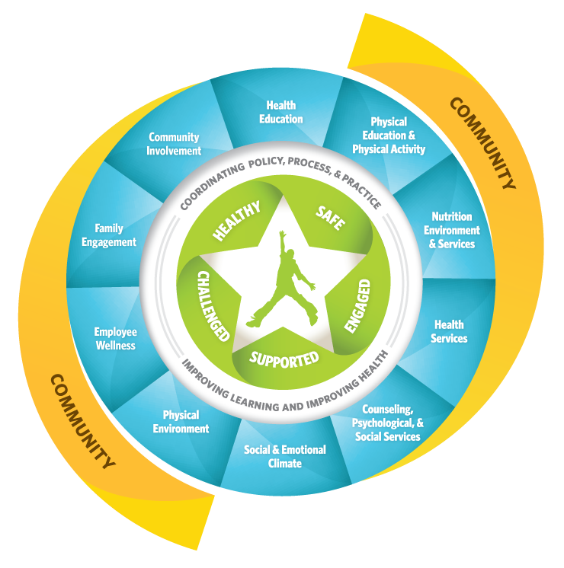
Whole School, Whole Community,
Whole Child
A collaborative approach to learning and health

Slide 4
Safety
Physiological
Love & Belonging
Esteem
Challenged
Actualization
Supported
Engaged
Safe
Healthy
ASCD’s Whole Child Tenets
Abraham Maslow’s Hierarchy of Needs
Notes:
When students’ basic physiological and psychological needs—including being physically healthy, socially and emotionally safe, connected, and secure—are satisfied, they are more likely to
Become engaged in school.
Act in accord with school goals and values.
Develop social skills and understanding.
Contribute to the school and community.
Achieve academically.
Further, when schools fail to meet those needs, students are more likely to become less motivated, more alienated, and poorer academic performers.
We declared that a whole child approach to education is one that ensures each child is healthy, safe, engaged, supported, and challenged and arranged these tenets as a hierarchy so as to portray the need to ensure a foundational focus on health and well-being of each student, adult, and environment.

Slide 5
HEALTHY
SAFE
ENGAGED
SUPPORTED
CHALLENGED

Slide 6
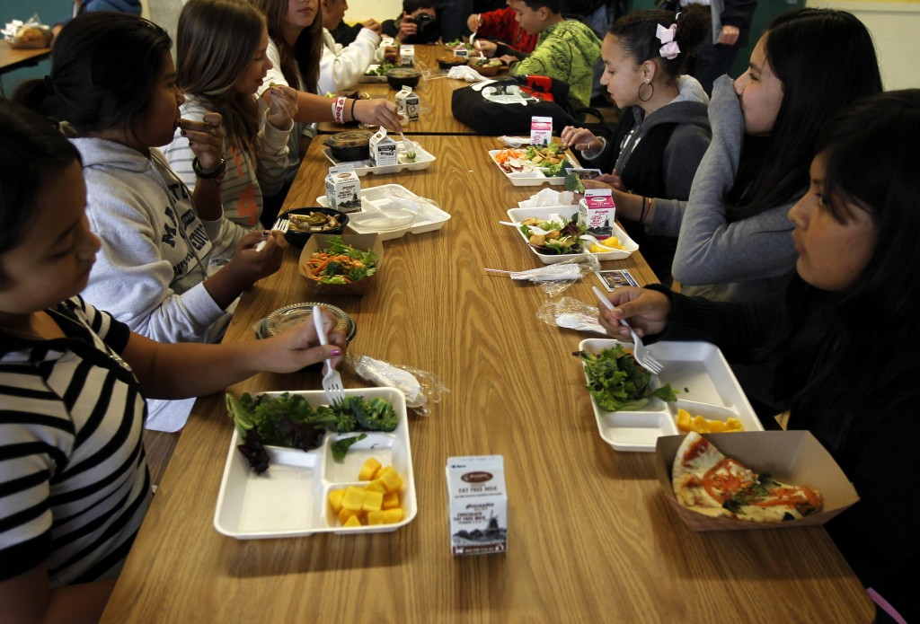
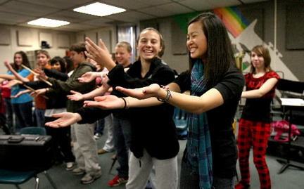
Healthy: Each student enters school healthy and learns about and practices a healthy lifestyle.

Slide 7
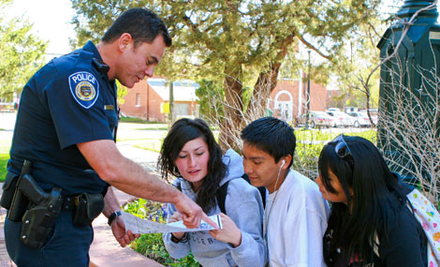
Safe: Each student learns in an environment that is physically and emotionally safe for students and adults.

Slide 8
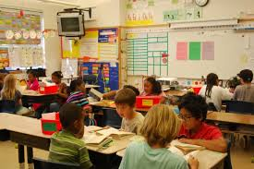
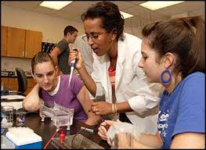
Engaged: Each student is actively engaged in learning and is connected to the school and broader community.

Slide 9
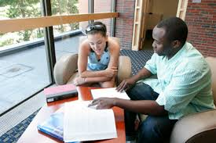
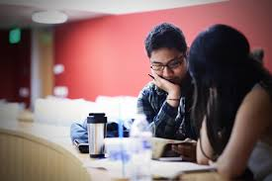
Supported: Each student has access to personalized learning and supported by qualified, caring adults.

Slide 10
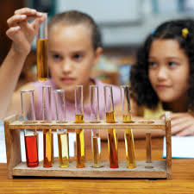
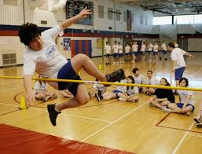
Challenged: Each student is challenged and prepared for success in college and further study and for employment and participation in a global environment.

Slide 11
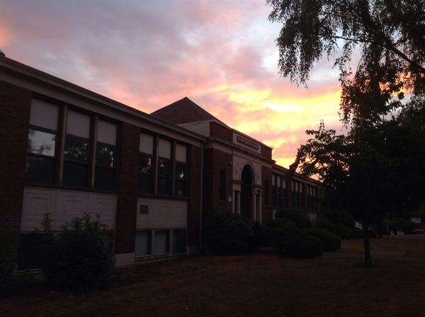
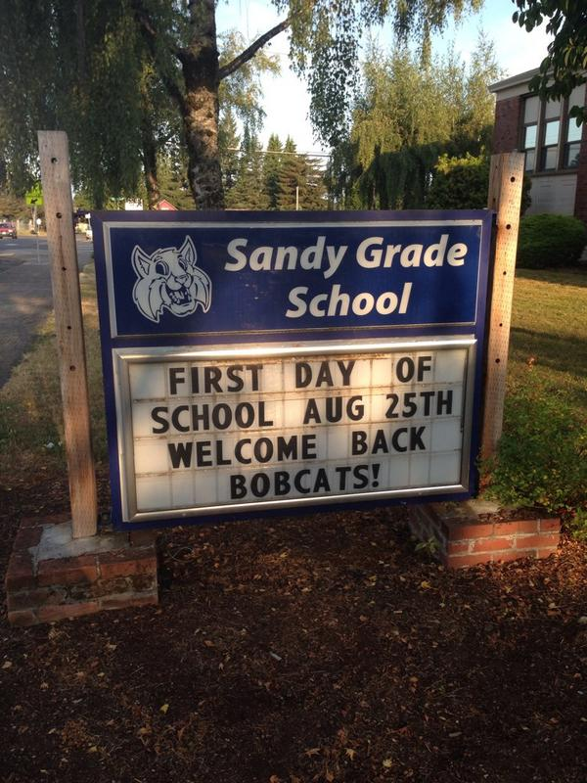
Sandy Grade School
Whole Child Award Winner!

Slide 12
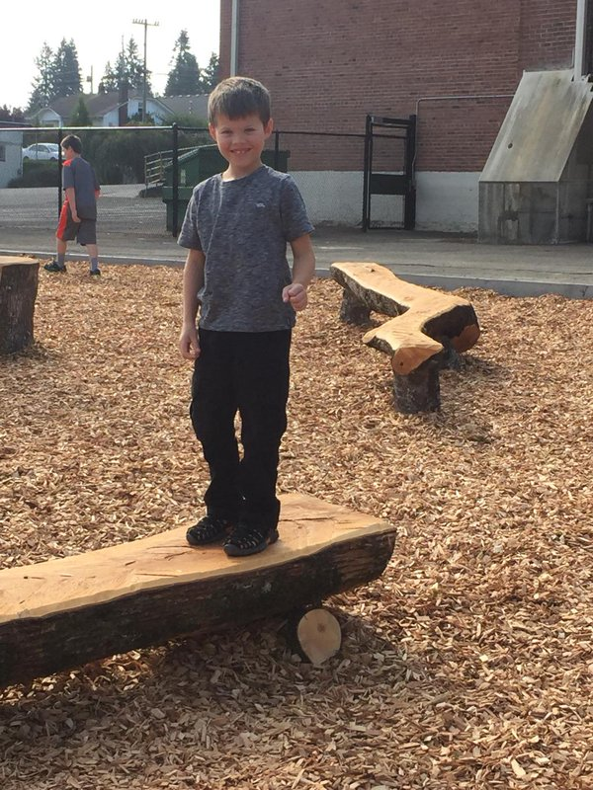
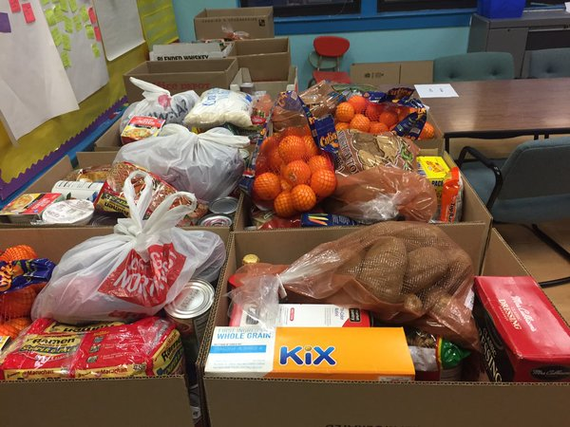
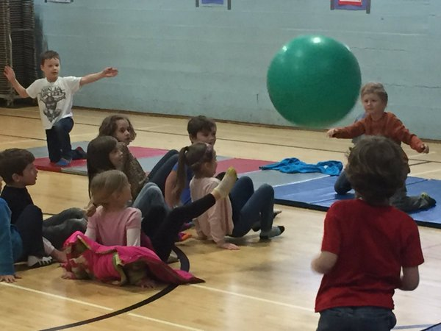
Healthy

Slide 13
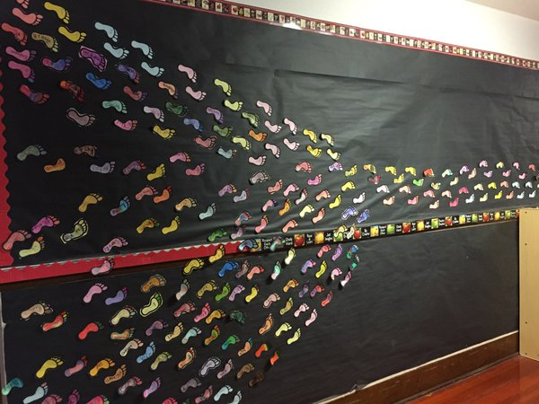
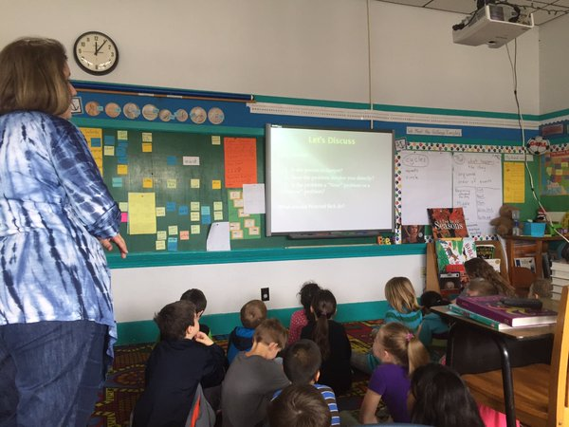
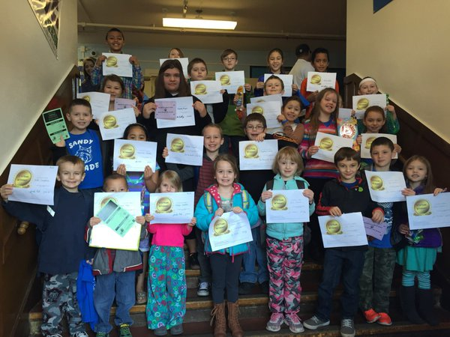
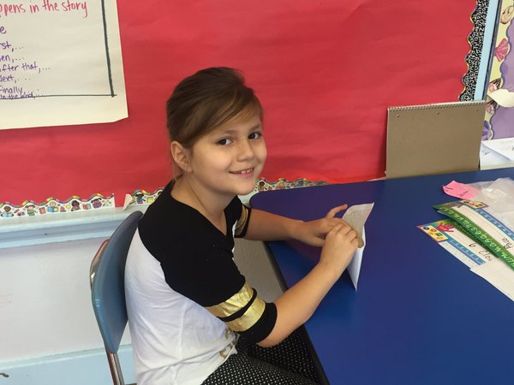
Safe

Slide 14
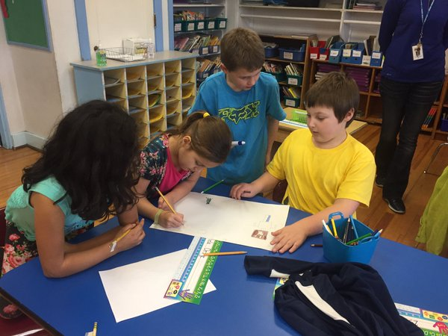
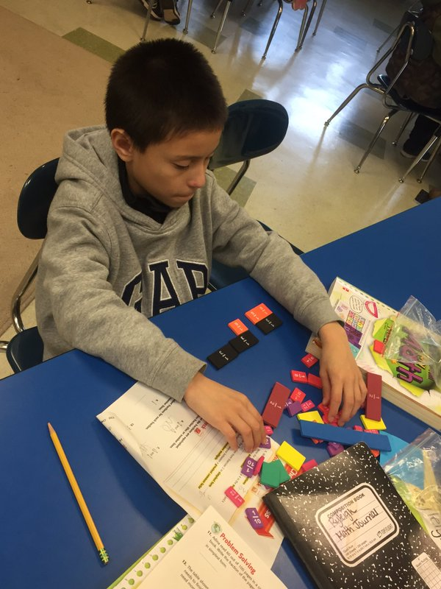
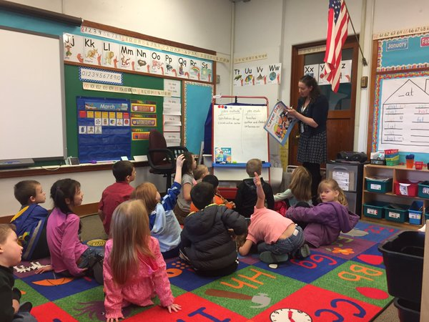
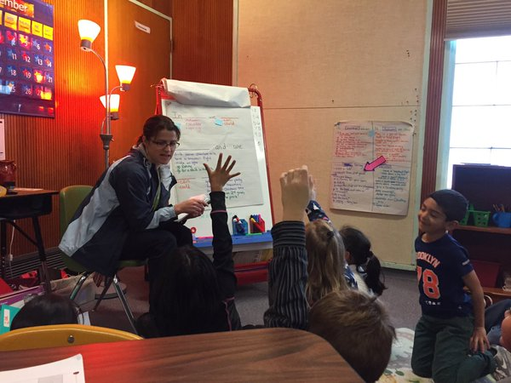
Engaged

Slide 15
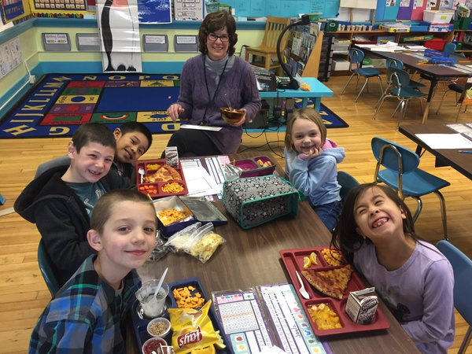
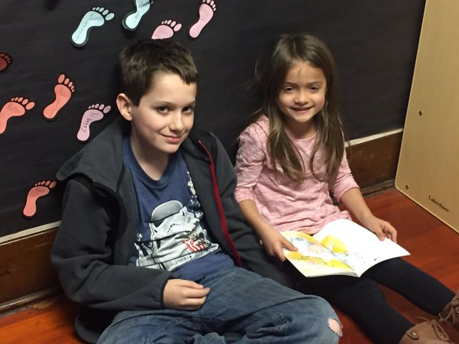
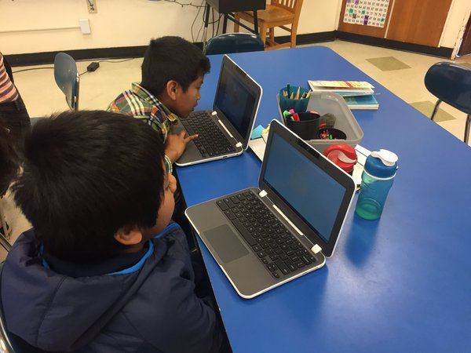
Supported

Slide 16
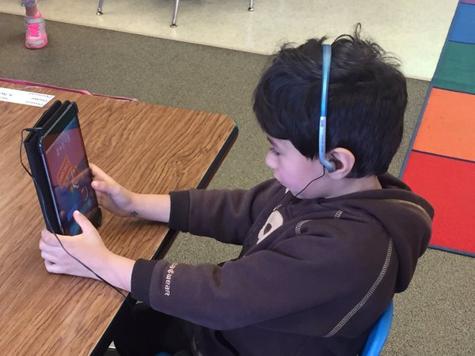
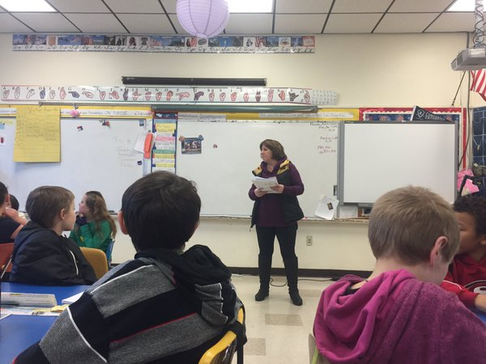
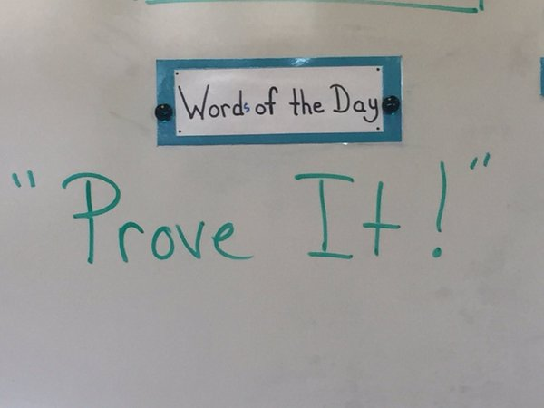
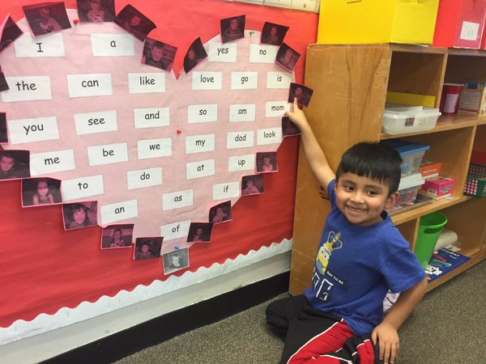
Challenged

