Slide 1
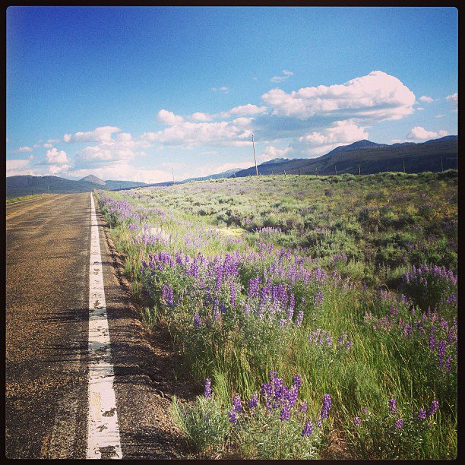
Creating Lasting School Health Programs
@cairnguidance
#OregonSEW
Jess Lawrence
www.cairnguidance.com

Slide 2
Turtle, Owl, Monkey
Go to the animal station that best resonates with you when you think of implementing SEW initiatives!
@cairnguidance
#OregonSEW
Jess Lawrence
www.cairnguidance.com
Notes:
“institutionalization,” “routinization,” or “incorporation.”
We defined it as: the continued use of program components and activities for the continued achievement of a desirable program and population outcome.

Slide 3
Sustainability
When you hear the word sustainability,
what words, images, thoughts come to mind?
@cairnguidance
#OregonSEW
Jess Lawrence
www.cairnguidance.com
Notes:
“institutionalization,” “routinization,” or “incorporation.”
We defined it as: the continued use of program components and activities for the continued achievement of a desirable program and population outcome.

Slide 4
Research
Project Background
Literature search within peer-reviewed journals, interviews, surveys, focus groups and internal documents
Components (10 of them!)
@cairnguidance
#OregonSEW
Jess Lawrence
www.cairnguidance.com
Notes:
Over 100 articles & documents reviewed included topics within all different school content areas: substance abuse, violence, mental health, teen pregnancy, asthma, oral health, PA, school connectedness and engagement, sleep, depression, nutrition, sexual behaviors, CSH
Documents from reliable organizations- ACS, CDC ASCD, etc.

Slide 5
Components
Readiness
Strategic Planning
Environmental Support
Resource Stability
Organizational Capacity
Program Evaluation
Program Adaptation
Partnership and Community Engagement
Communication & Messaging
Alignment to Educational Accountability Measures
@cairnguidance
#OregonSEW
Jess Lawrence
www.cairnguidance.com
Notes:
10 key components.
Do as a jigsaw around room. They go to station and read one pager and come up with a PA and then report out 2 main ideas.

Slide 6
From Statewide Implementation to School-wide
Humana Vitality- SWARM (Students With Active Role Models)
Zumba- MacBrayer Elementary School, Morehead KY
@cairnguidance
#OregonSEW
Jess Lawrence
www.cairnguidance.com
@cairnguidance
#OregonSEW
Notes:
10 key components.
Do as a jigsaw around room. They go to station and read one pager and come up with a PA and then report out 2 main ideas.

Slide 7
Stairwell Speech
Pick an audience (person or organization)
What about sustainable school employee wellness programs do you want to communicate?
Write down your top 3 talking points
@cairnguidance
#OregonSEW
Jess Lawrence
www.cairnguidance.com

Slide 8
Stairwell Speech
Step 1: Get up and Talk!
Step 2: Pair up and Advocate!
Step 3: Sit down & Capture it!
@cairnguidance
#OregonSEW
Jess Lawrence
www.cairnguidance.com

Slide 9

Questions?
@cairnguidance
#OregonSEW
Jess Lawrence
www.cairnguidance.com

Slide 10
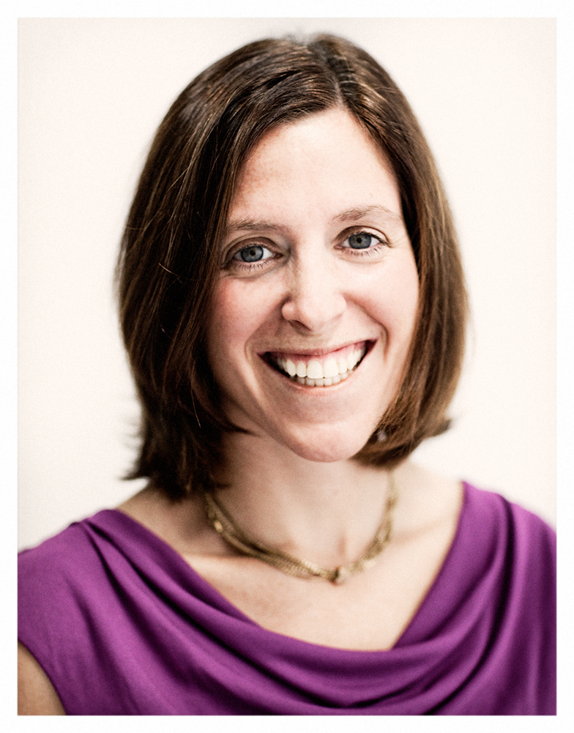
Jess Lawrence
Jess@cairnguidance.com
www.cairnguidance.com
@cairnguidance

